Slide 1
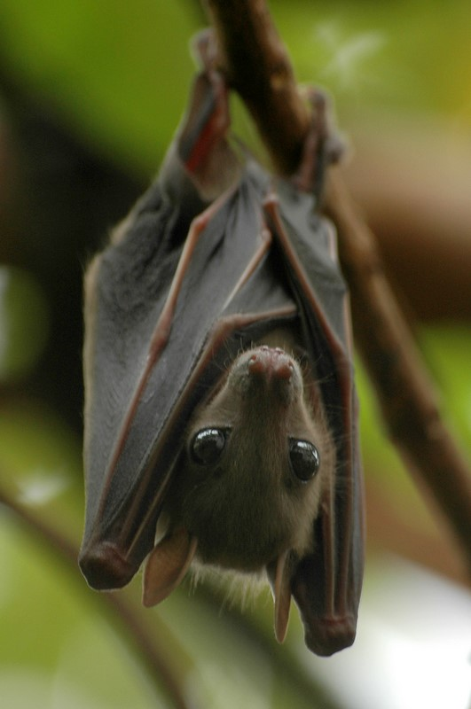
Bat Flight Simulation By: Alexander Mervar
Notable Tutorials and Sources for the Project:
Braitenberg Vehicles
Creating Animations in Python using MatPlotLib
How Bats Find their Prey
Braitenberg Vehicle Assignment
This Photo by Unknown Author is licensed under CC BY-NC-ND

